Slide 1

CSC 533: Privacy in the Digital Age (Fall 2020) Lecture 15: Federated Learning
Anupam Das
Oct. 8, 2020

Slide 2
Goals for today
Privacy-preserving collaborative machine learning technique
Federated learning
How Federated Learning works?
Some slide contents have been taken from Vitaly Shmatikov, Reza Shokri, Jakub Konečný

Slide 3
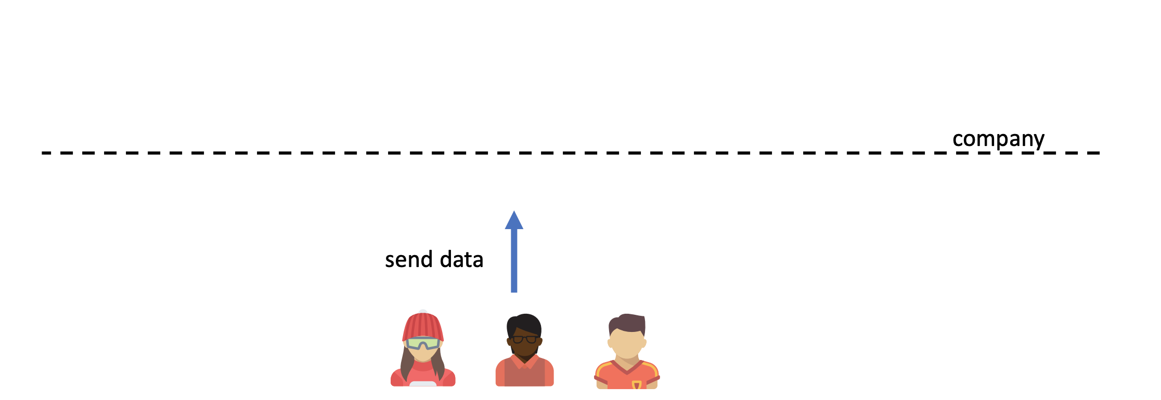
Common ML pipeline

Slide 4
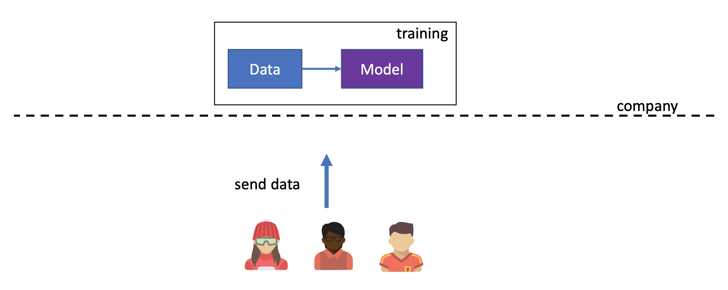
Model resides in cloud

Slide 5
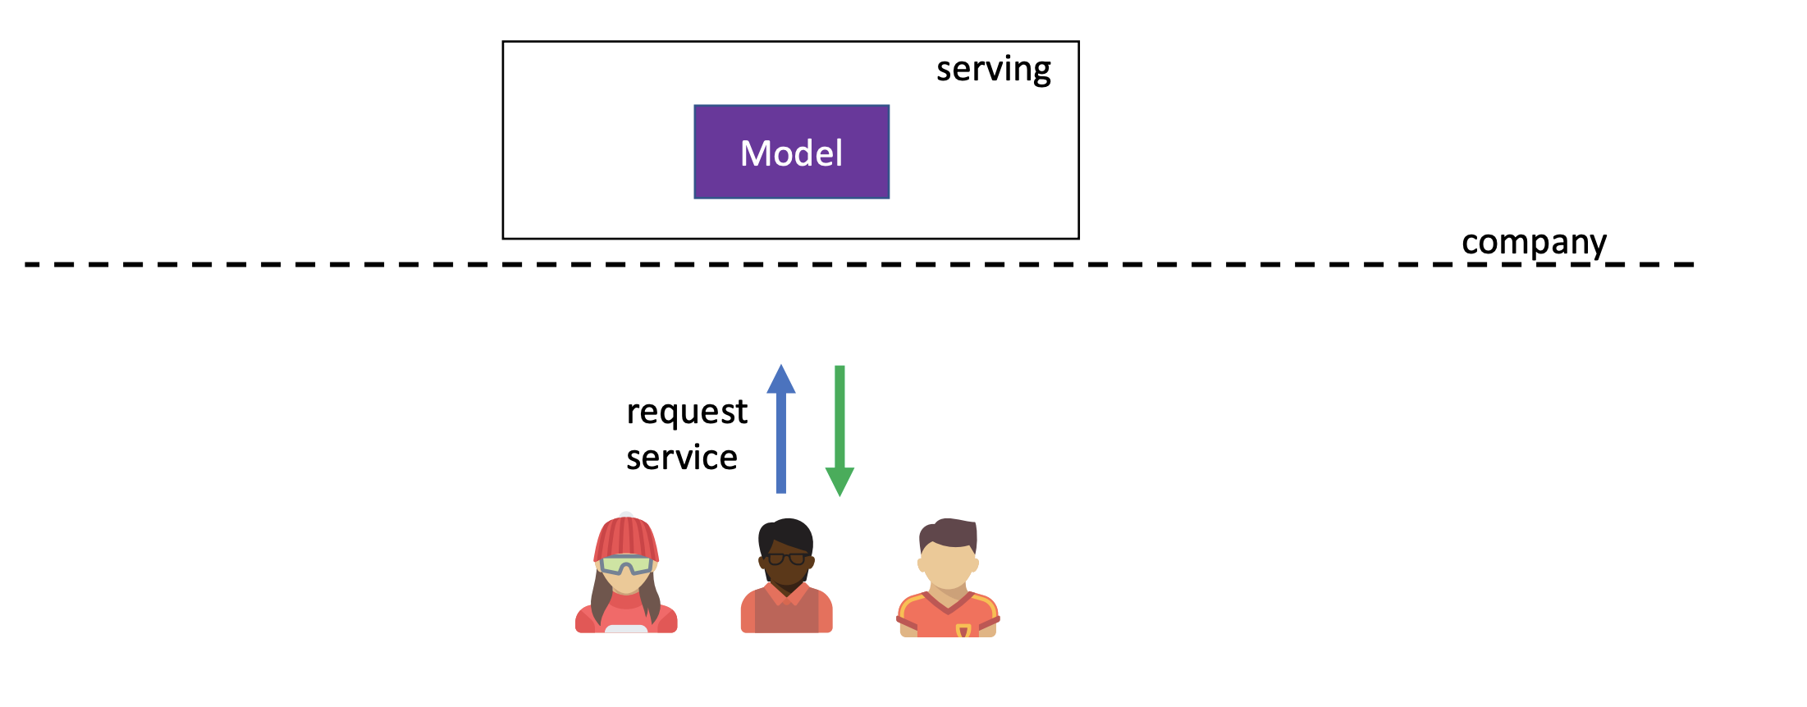
Query based ML service
What is the major problem here?

Slide 6
Privacy issues in traditional approach
Data leaves users’ control
Where it is stored
How is it used
Who is it shared with
Data is revealed to the third-party services
Data breach can happen on servers

Slide 7
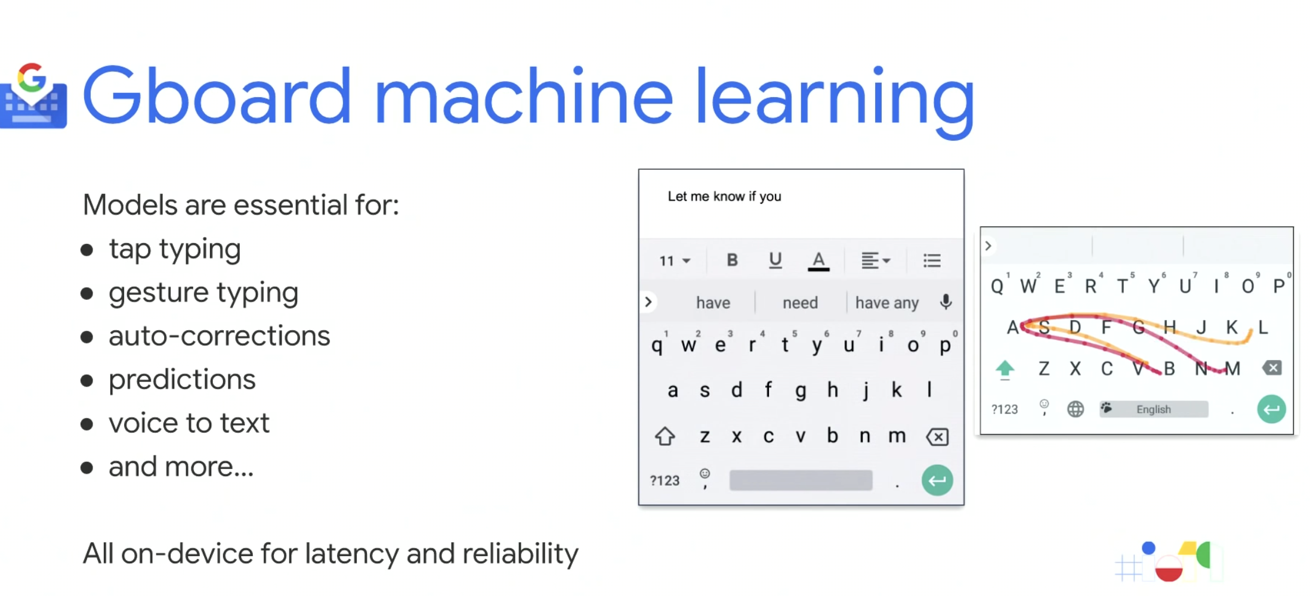
Example: Predictive keyboard
Users don’t like typing and do it with mistakes
Solution: predictive keyboard/search that suggests next word to type
Use Machine Learning to build good model

Slide 8
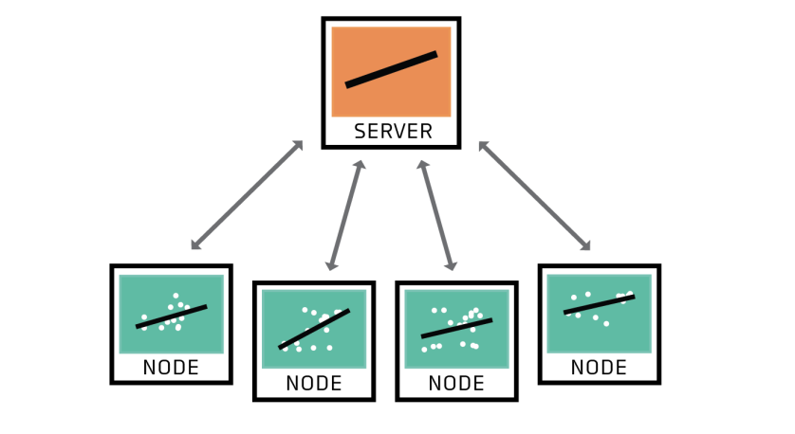
Federated Learning
A network of nodes shares models rather than training data with the server

Slide 9
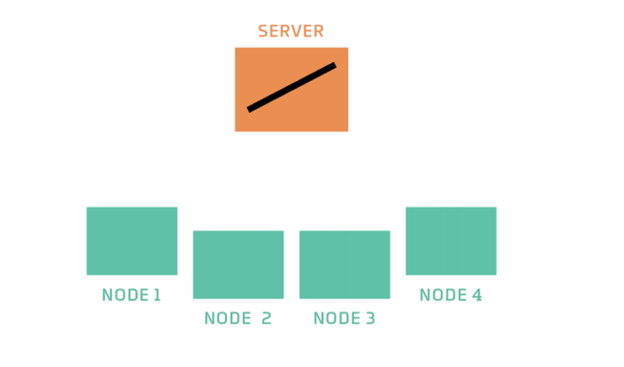
High-level process
The server has an untrained model
It sends a copy of that model to the nodes
The nodes have data on which to train their model
Each node trains the model to fit the data they have
Each node sends a copy of its trained model back to the server
The server combines these models by taking an average
The server now has a model that captures the patterns in the training data on all the nodes

Slide 10






Distributed / Federated Learning
Multiple clients want to collaboratively train a model
Server
Gboard
Tensorflow Federated

Slide 11
Distributed / Federated Learning
In each iteration
Multiple clients want to collaboratively train a model
Server
Download global model from server

Slide 12
Distributed / Federated Learning
In each iteration
Multiple clients want to collaboratively train a model
Server
Share model updates
Sharing updates rather than data...
Train on a batch

Slide 13
Google’s promotion on federated learning
https://youtu.be/gbRJPa9d-VU

Slide 14
Federated learning benefits
Non-IID – every user has different data;
Unbalanced – some users have more data than others;
Massively distributed – millions of smartphones;
Limited communication – mobile devices are frequently offline or on slow or expensive connections.

Slide 15
Is Federated learning different?
What is different from traditional data center based MapReduce?
Limited communication
Intermittent compute node availability
Intermittent data availability
Massively distributed
Privacy preserving aggregation

Slide 16
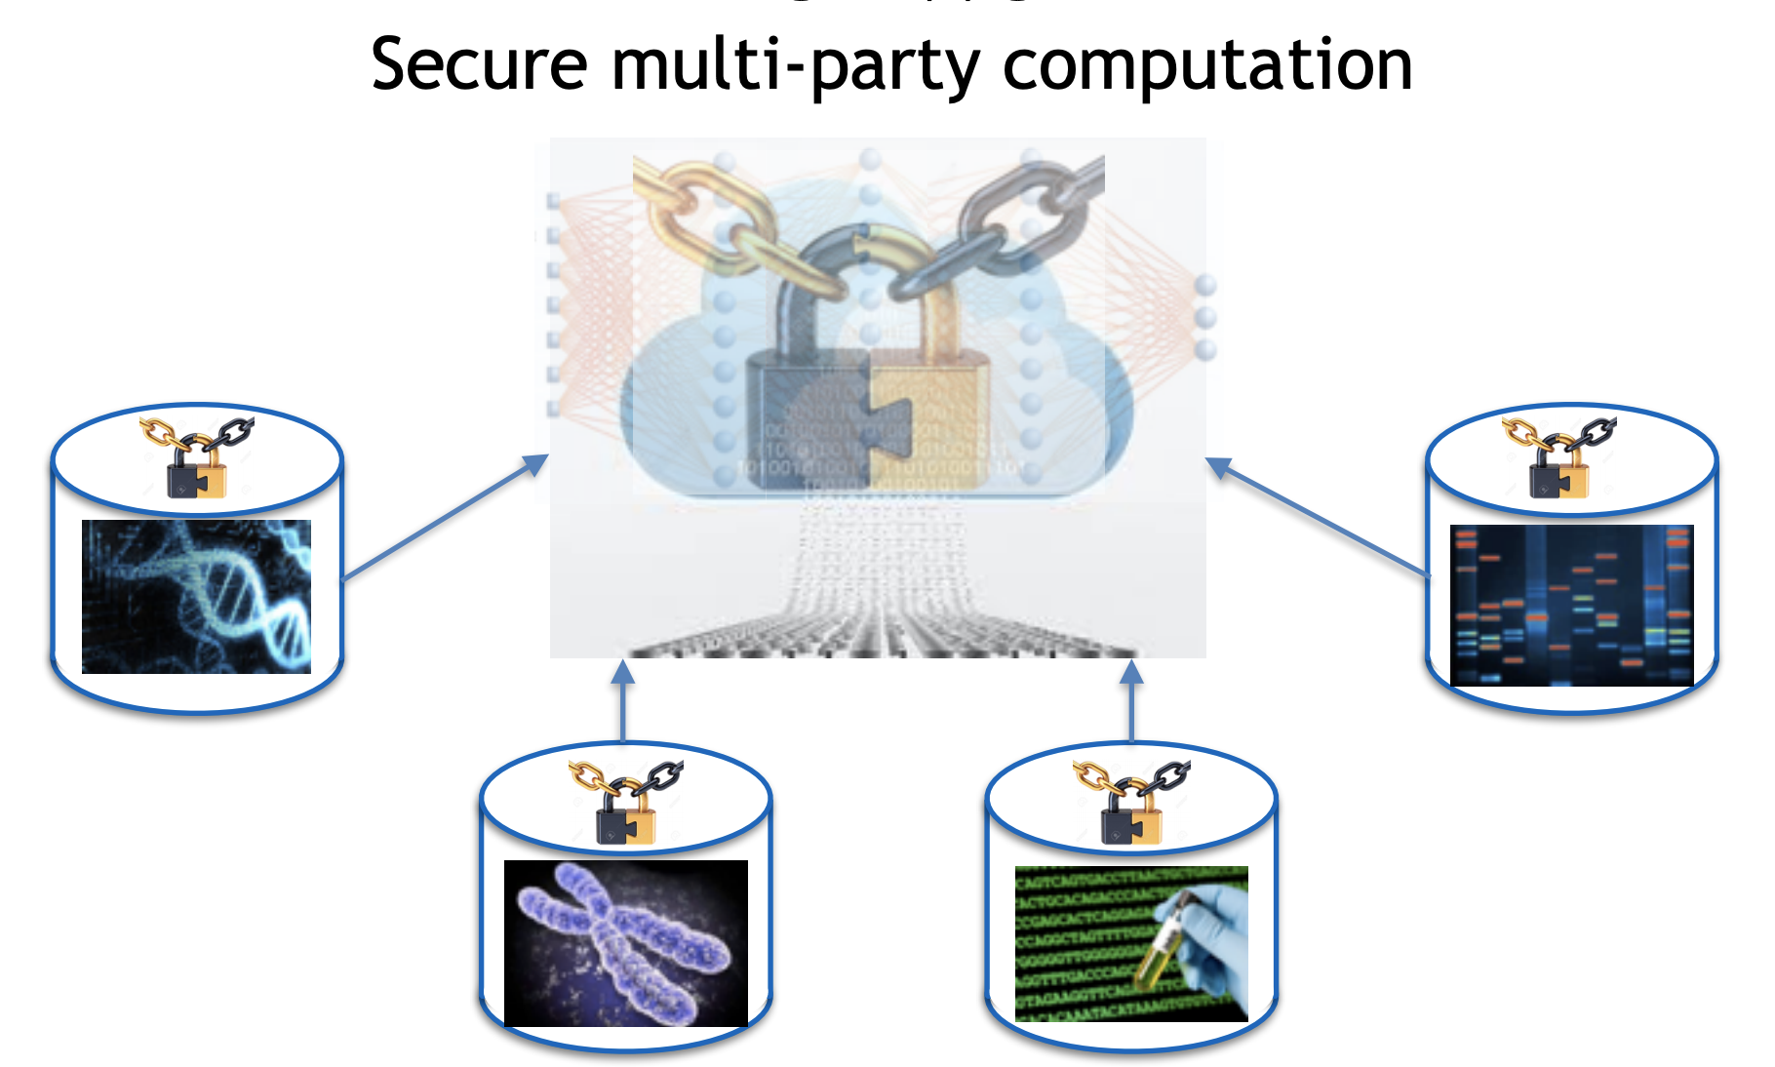
What about secure MPC?
Consider different hospitals want to participate in collaborative learning
Perform computation on encrypted data:
homomorphic encryption
Garble circuit
Oblivious transfer
Not always easy to map to arbitrary function
Computationally expensive

Slide 17
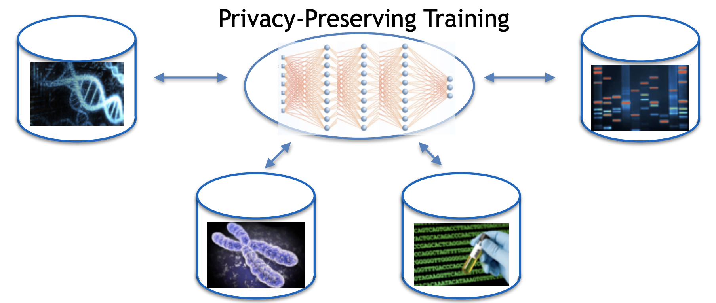
Is there another way?
Consider different hospitals want to participate in collaborative learning
Data resides at each institution's

Slide 18
How does it really work?

Slide 19
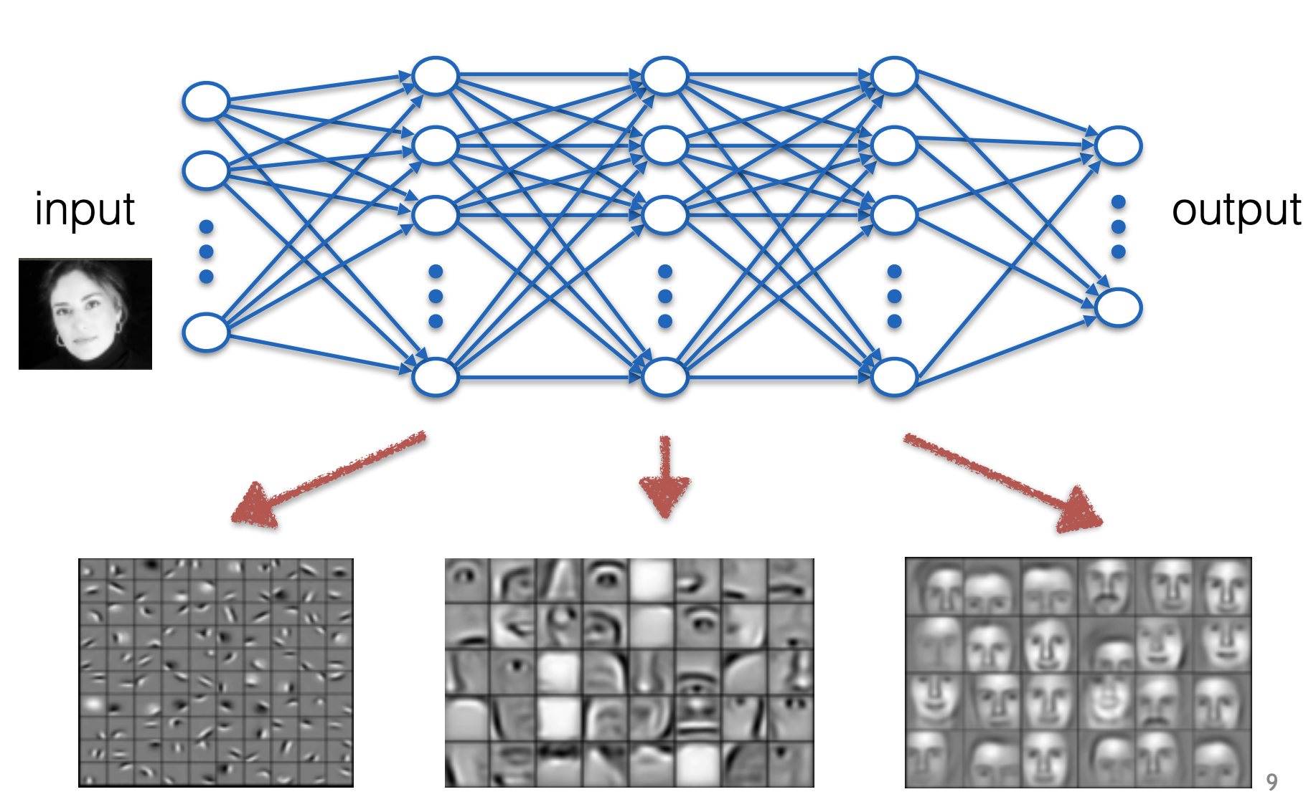
Neural Networks

Slide 20
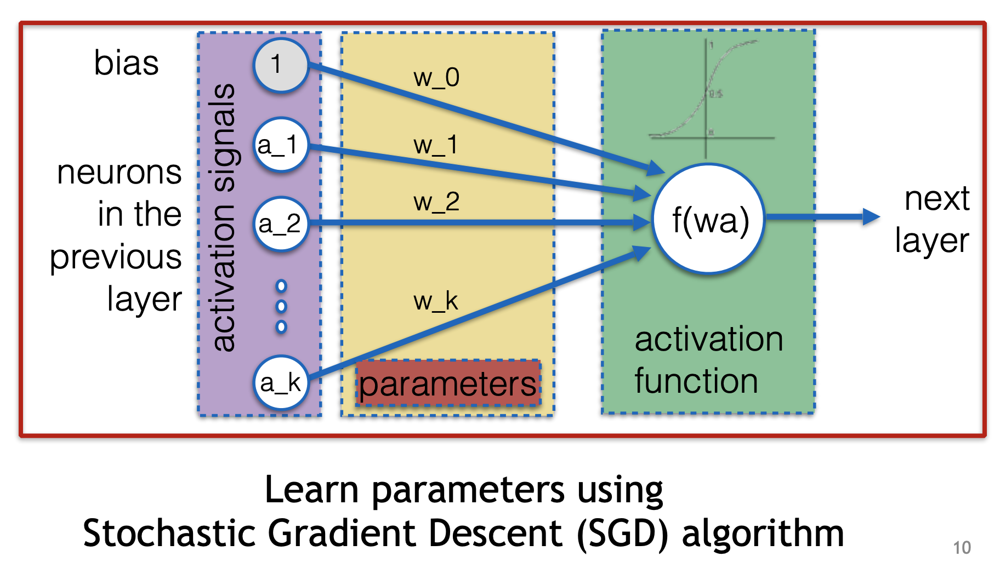
How neurons look?

Slide 21
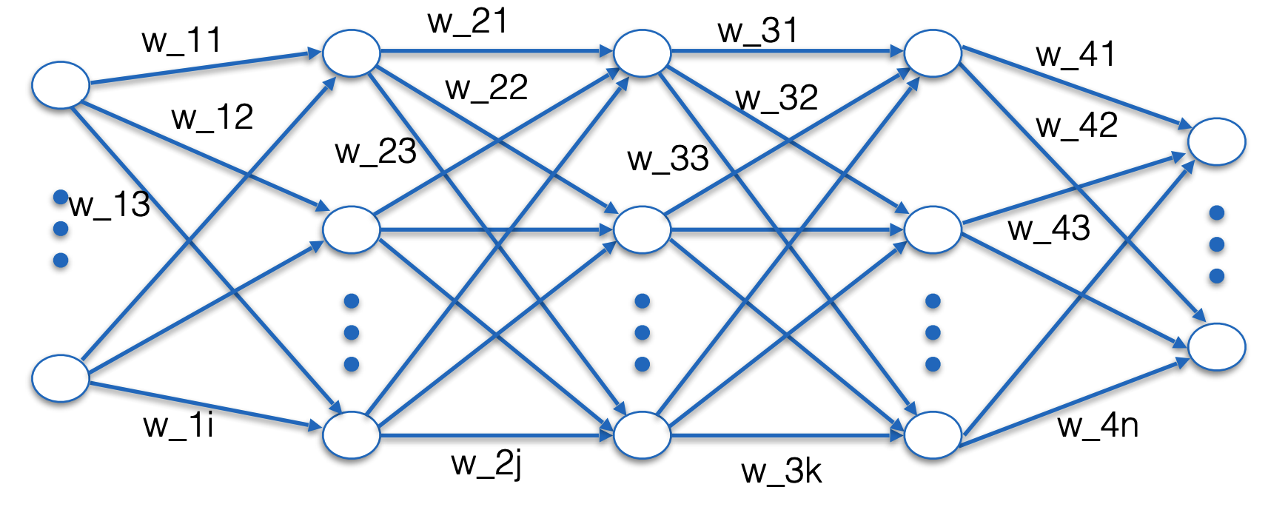
Parameter Training using SGD
Find parameters that minimize the classification error

Slide 22
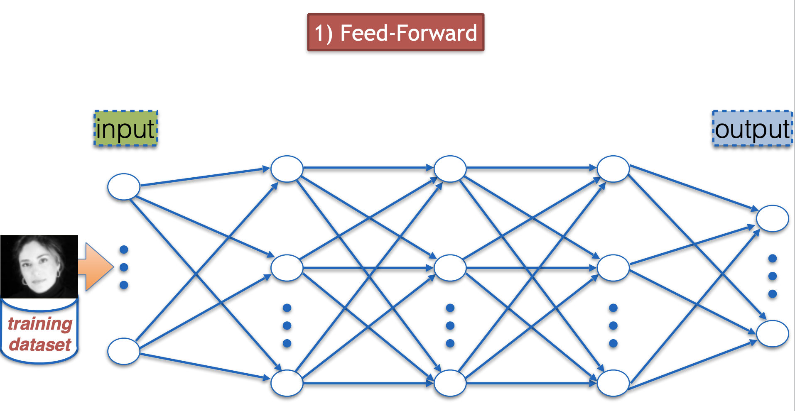
Parameter Training using SGD
Randomize the weights
Insert input and check output

Slide 23
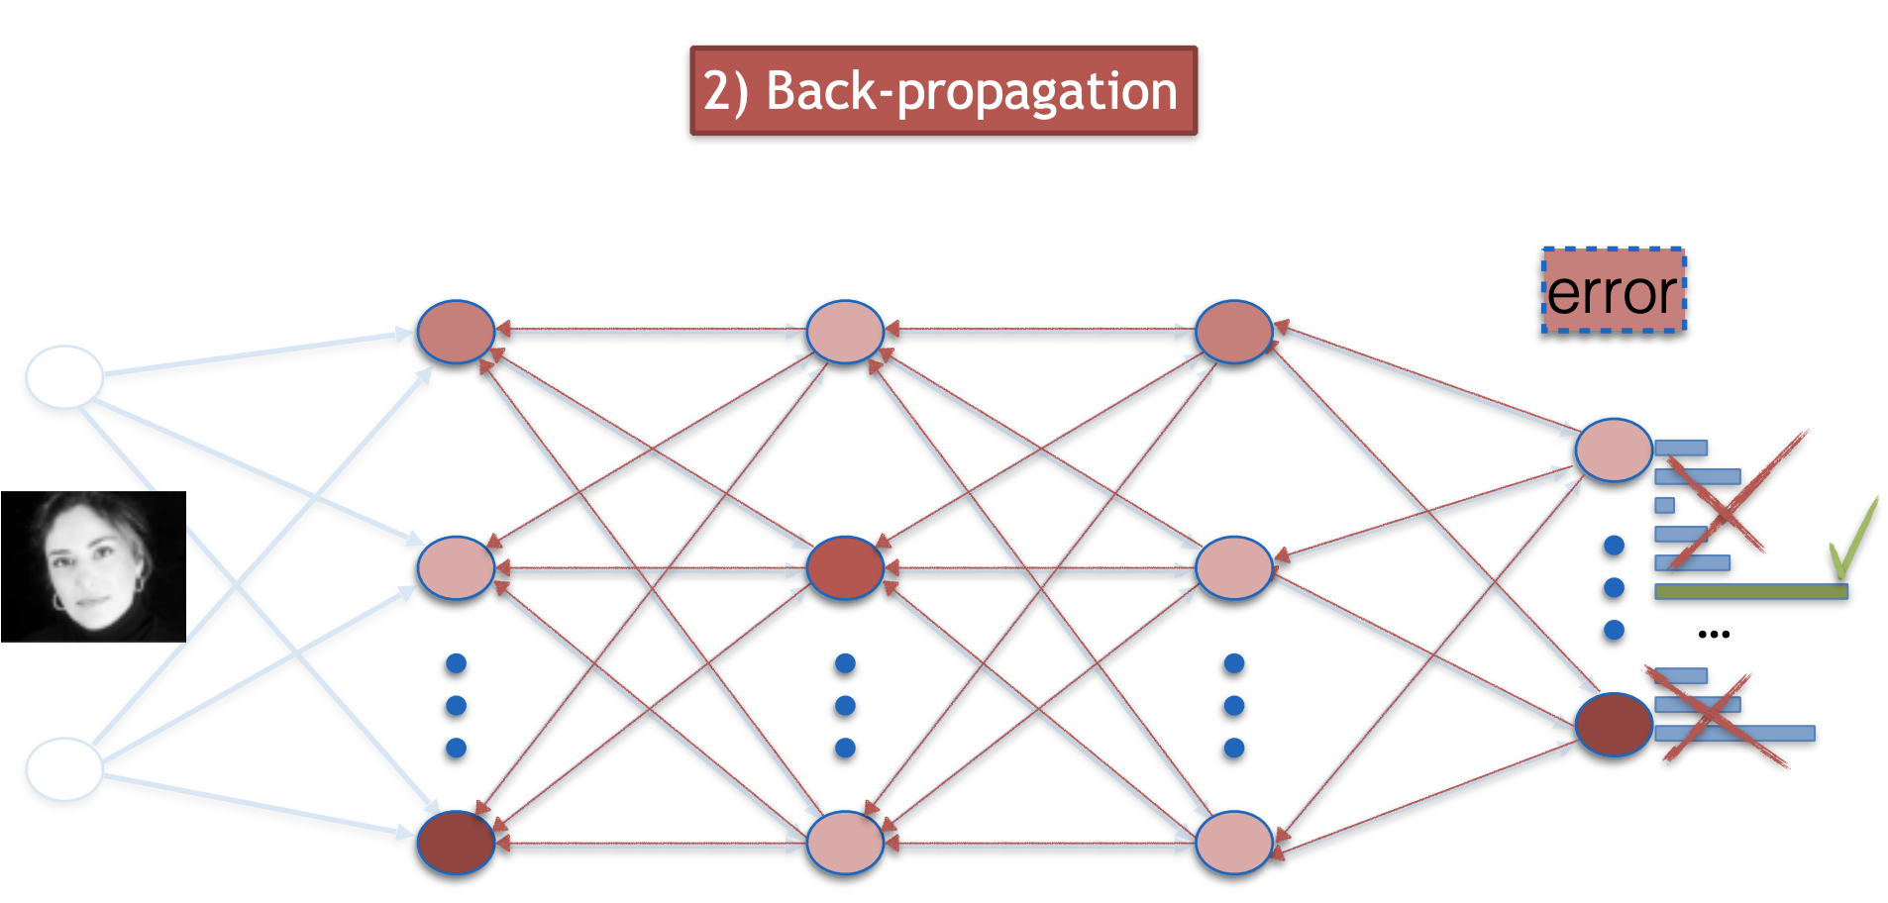
Parameter Training using SGD
Compare against expected output (error)

Slide 24
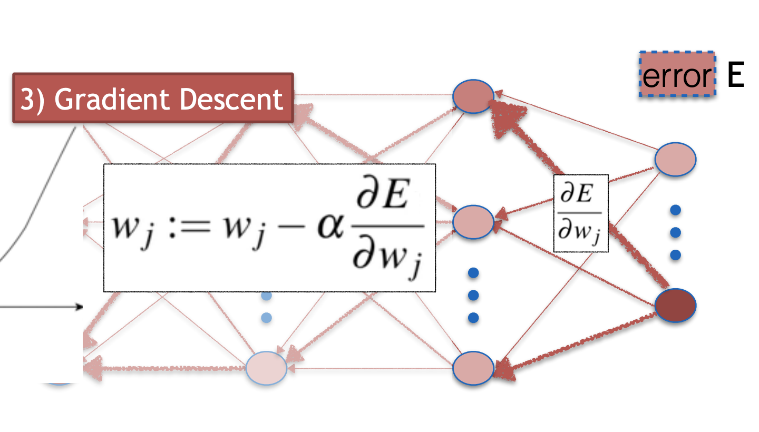
Stochastic Gradient Descent
Update weights proportional to error

Slide 25
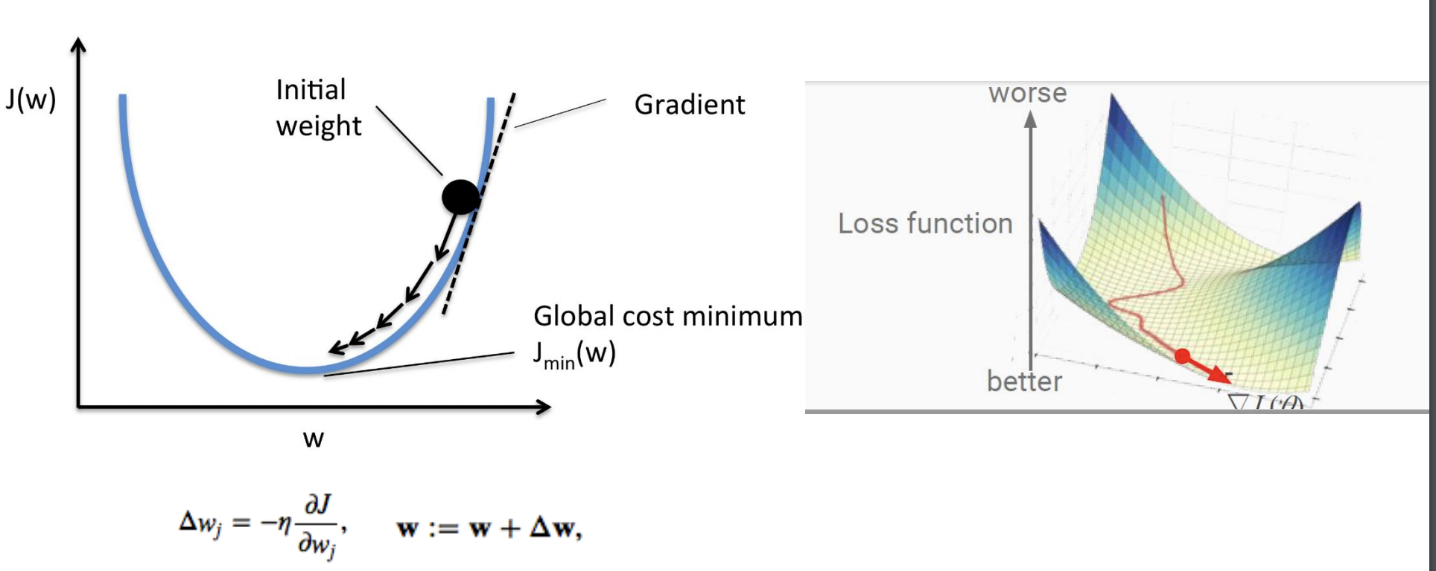
Stochastic Gradient Descent

Slide 26
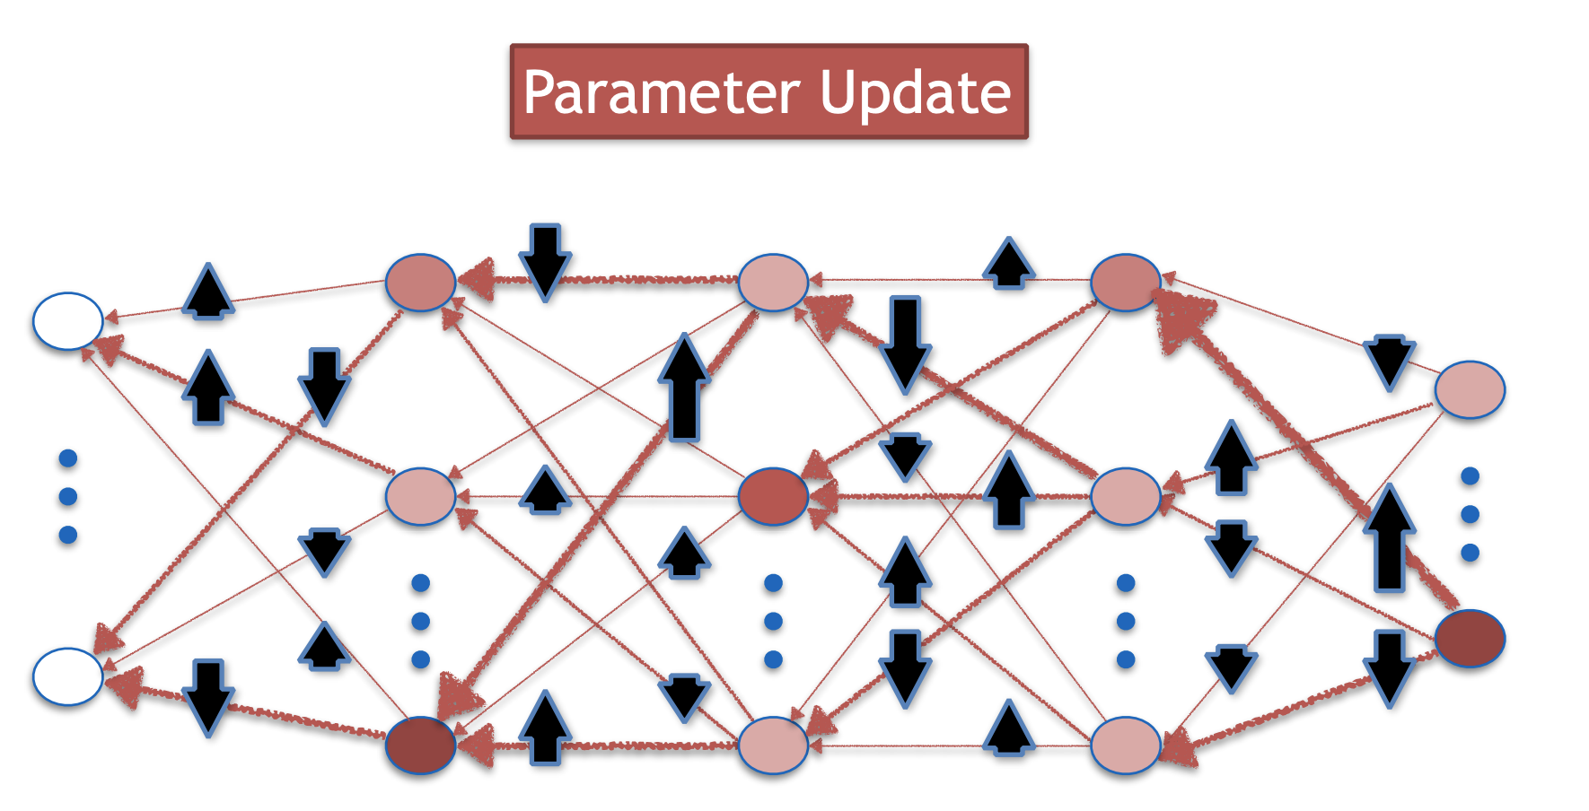
Parameter Training using SGD
Repeat for new batches of training data

Slide 27
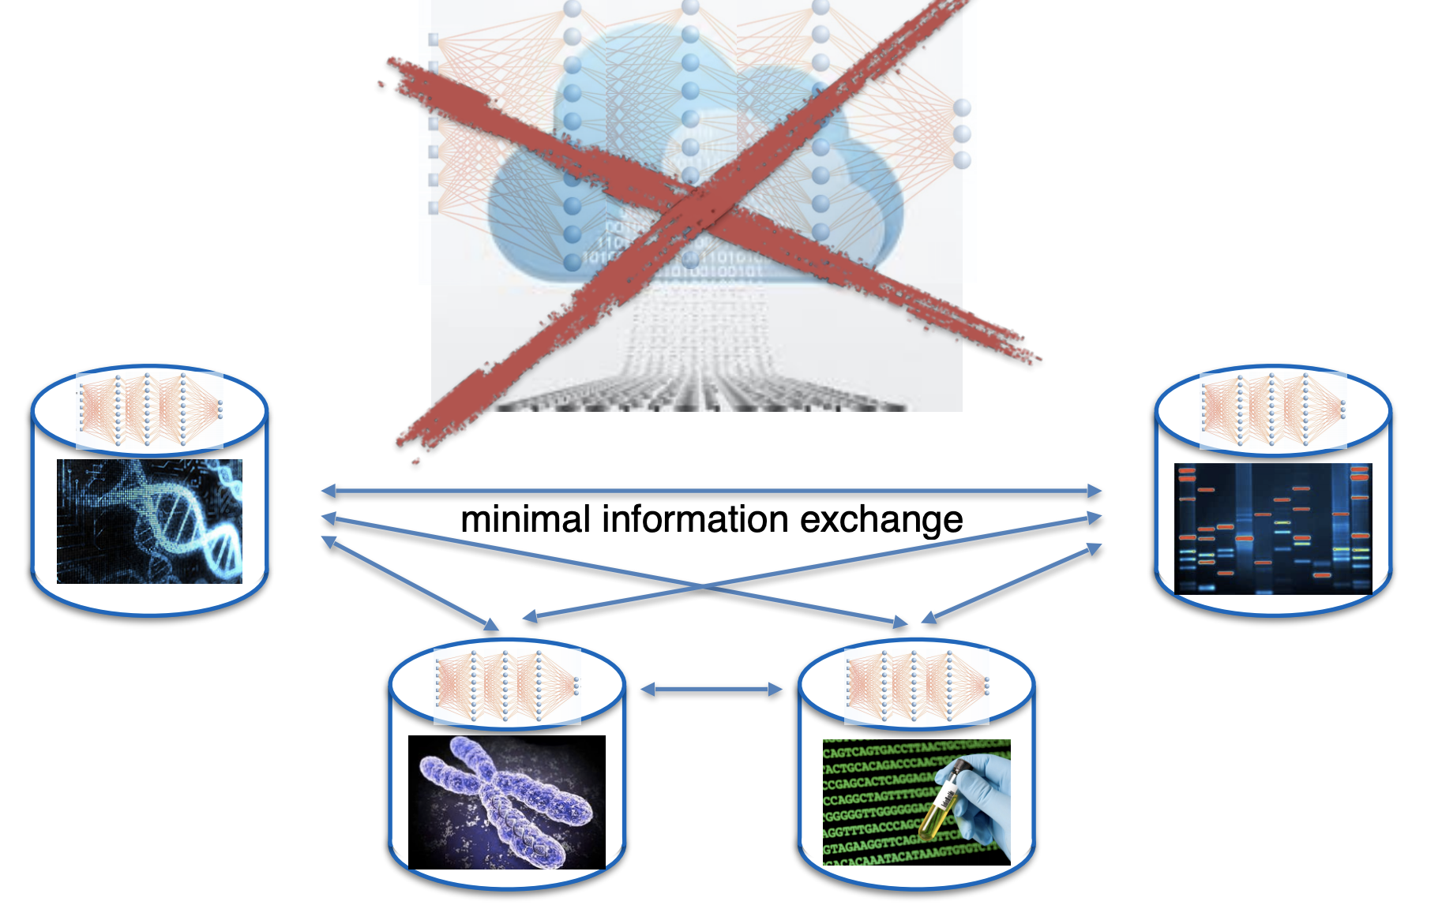
Distributed Selective SGD (DSSGD)

Slide 28
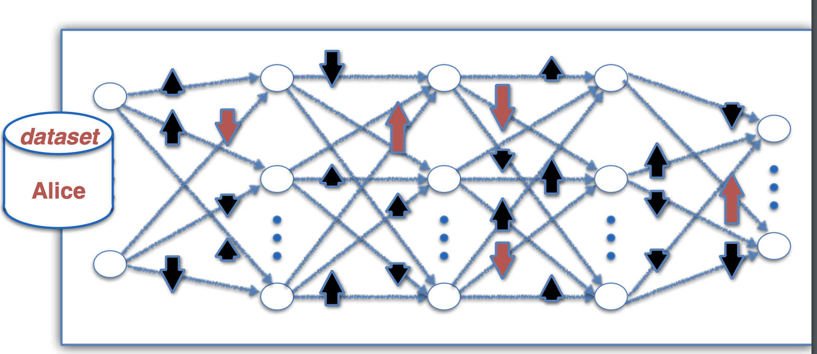
Selective SGD
Share with others

Slide 29
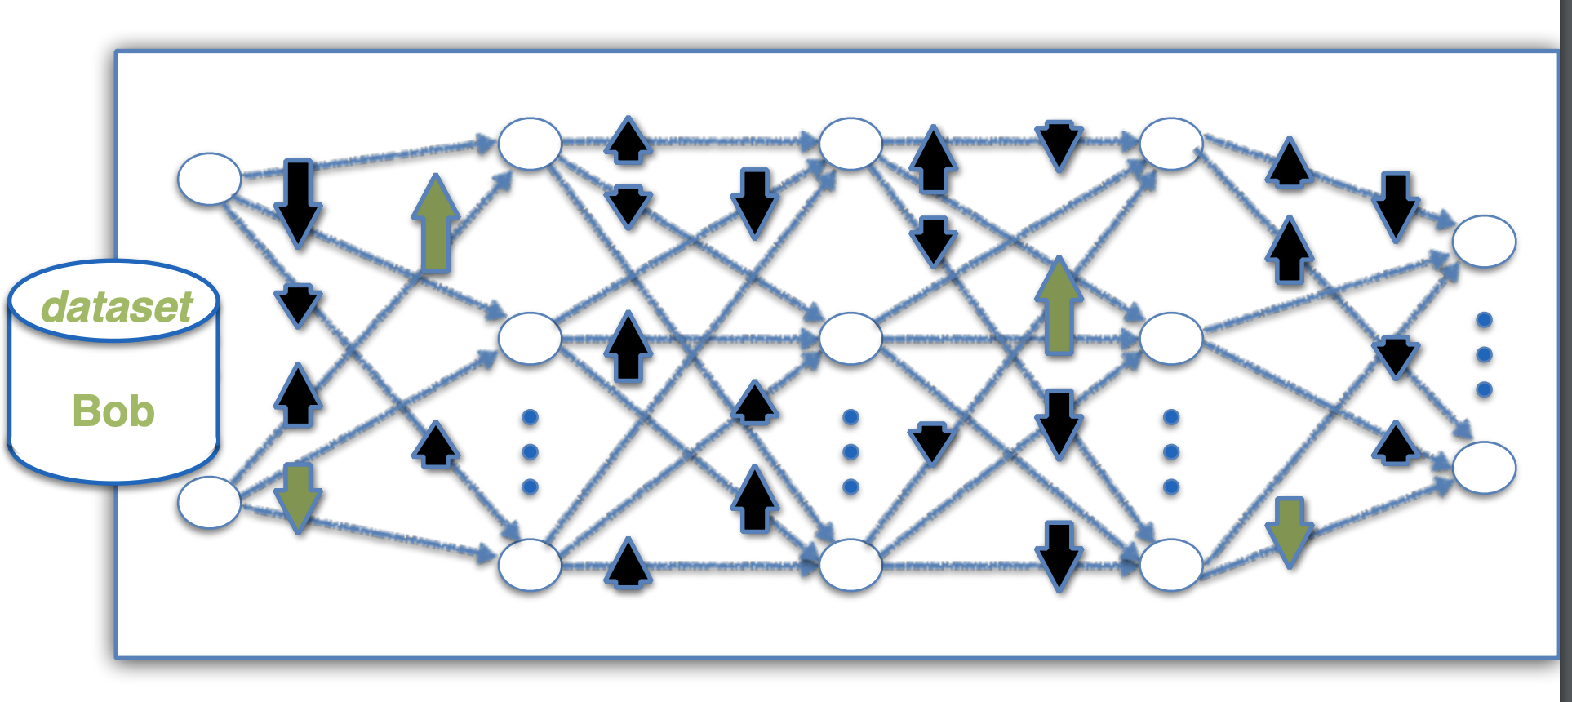
Selective SGD …
Share with others

Slide 30
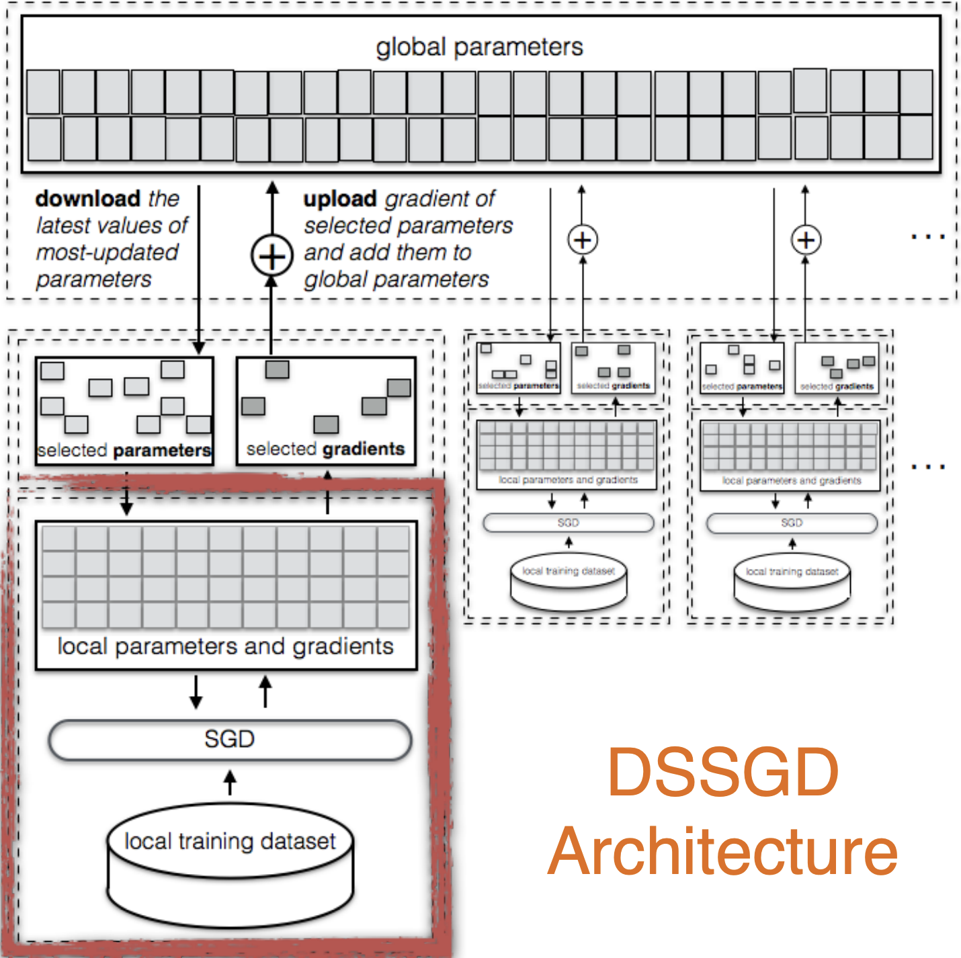
Overall architecture
Each node locally trains the model
Computes gradients for each parameter (weight)

Slide 31
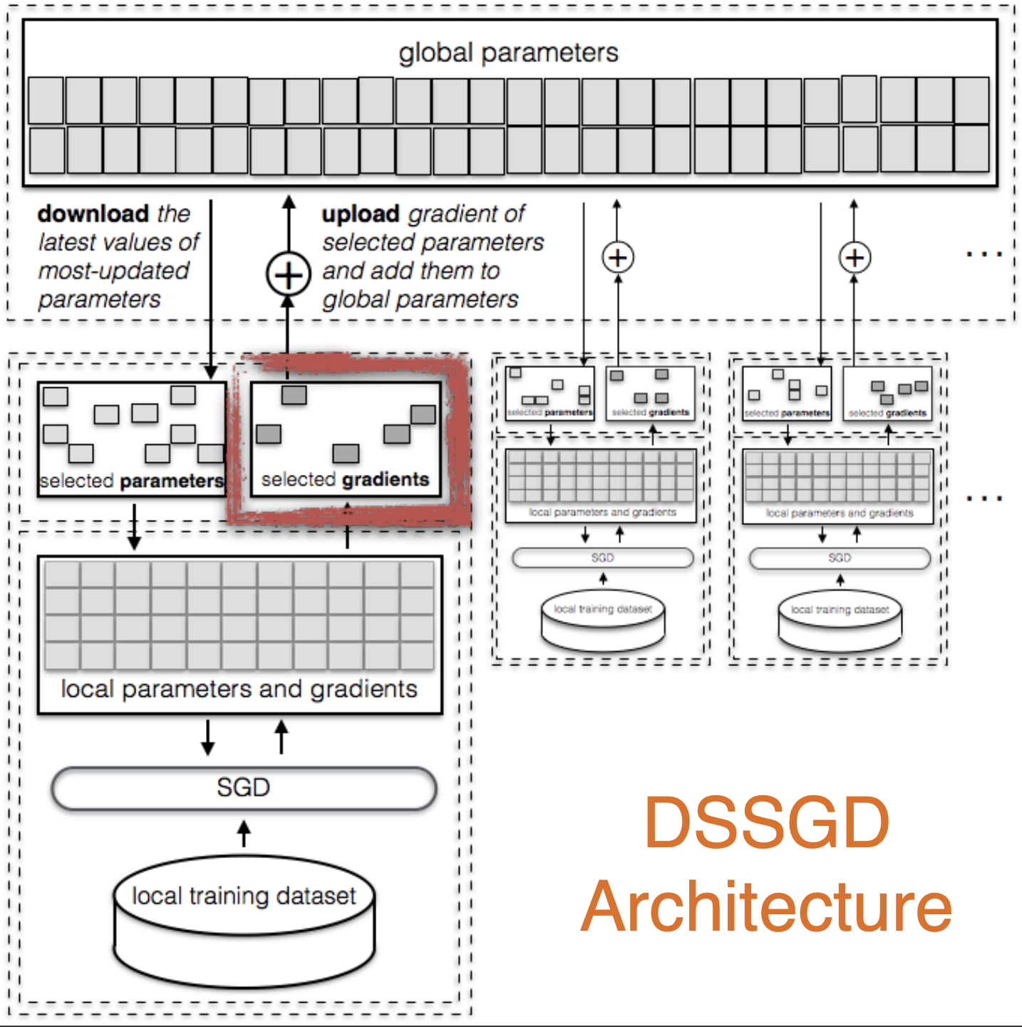
Gradient selection
Select gradients to upload
largest values
random with threshold (subsample gradient > threshold)

Slide 32
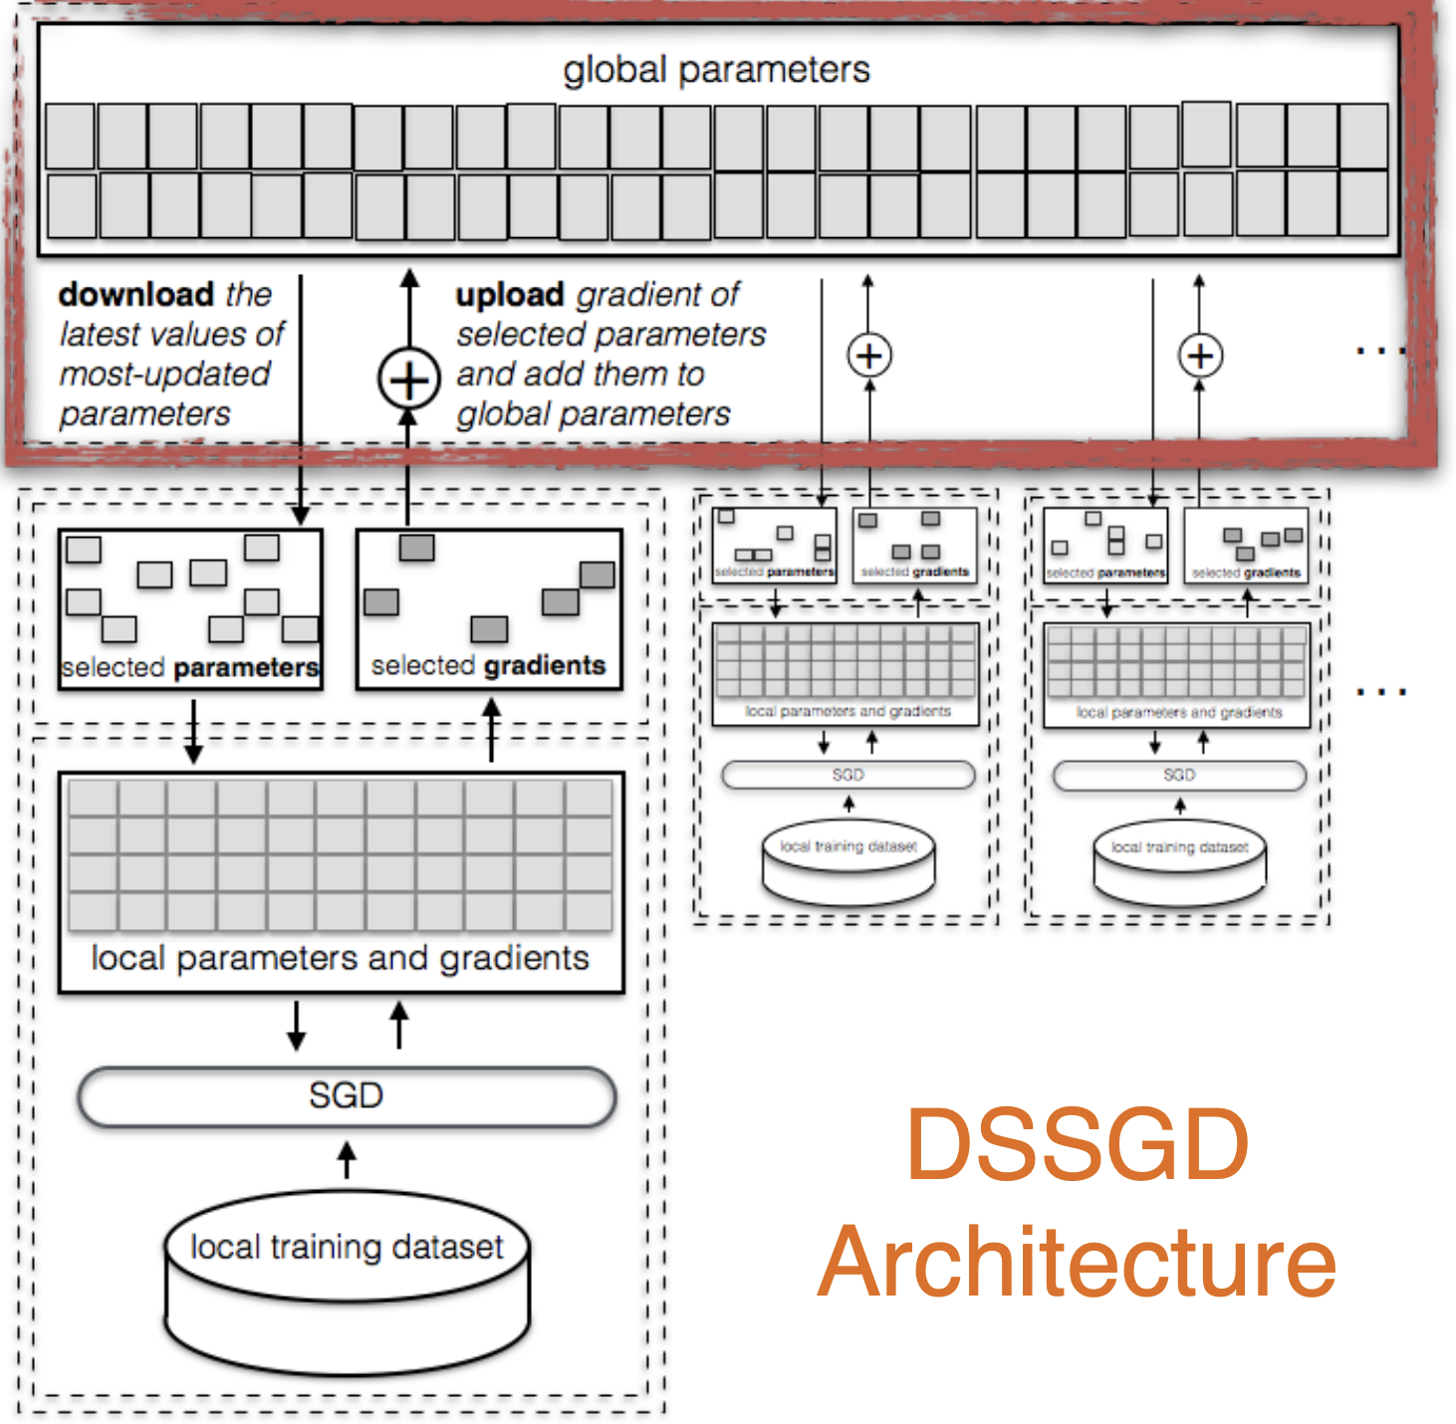
Update global model
Parameter server
Adds the uploaded weights
Updates the parameters for next iteration

Slide 33
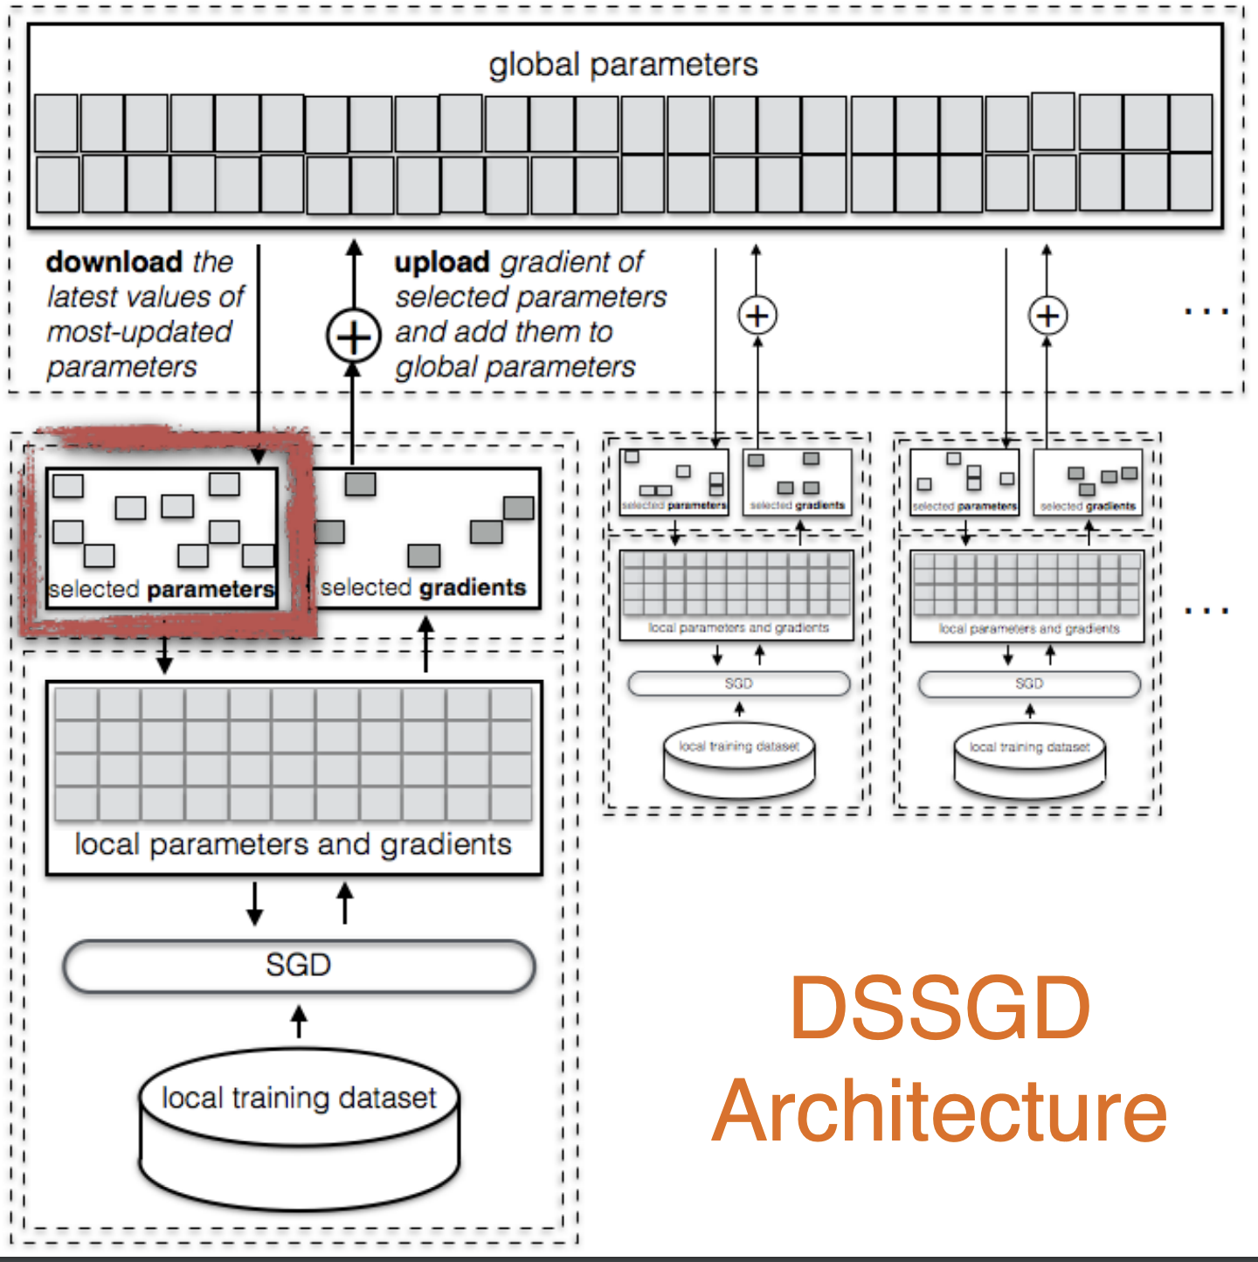
Iterative over again
Each node
Downloads the updated parameter
… process repeats again

Slide 34
Distributed Selective SGD
Local training, Global convergence
High training stochasticity (randomness)
Less overfitting

Slide 35
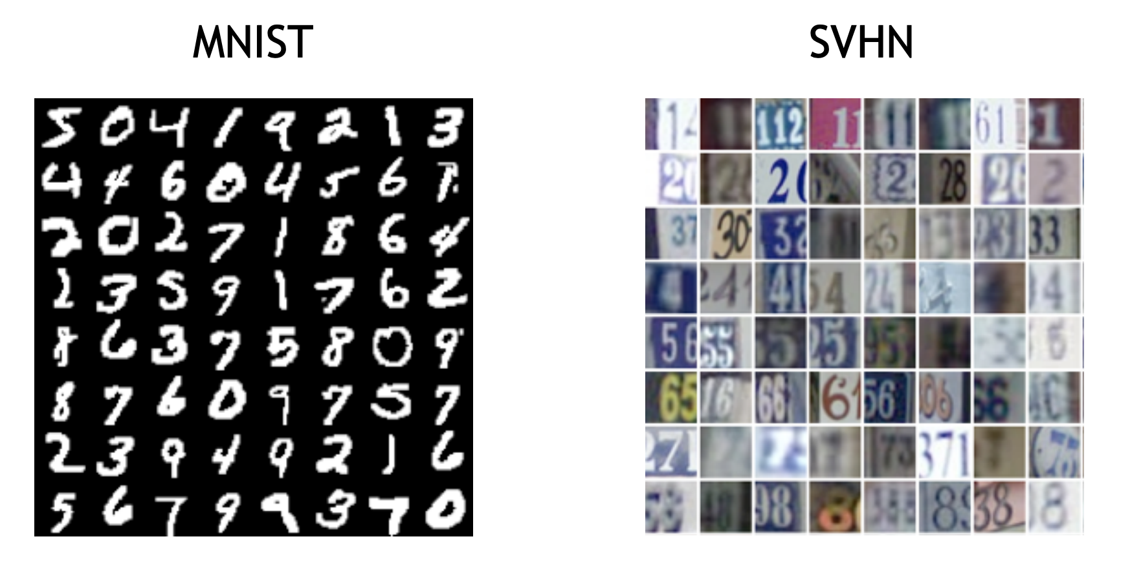
Evaluation
60000 training samples
10000 testing samples
Task: Find the digit in the image (classify into one of 10 classes)

Slide 36
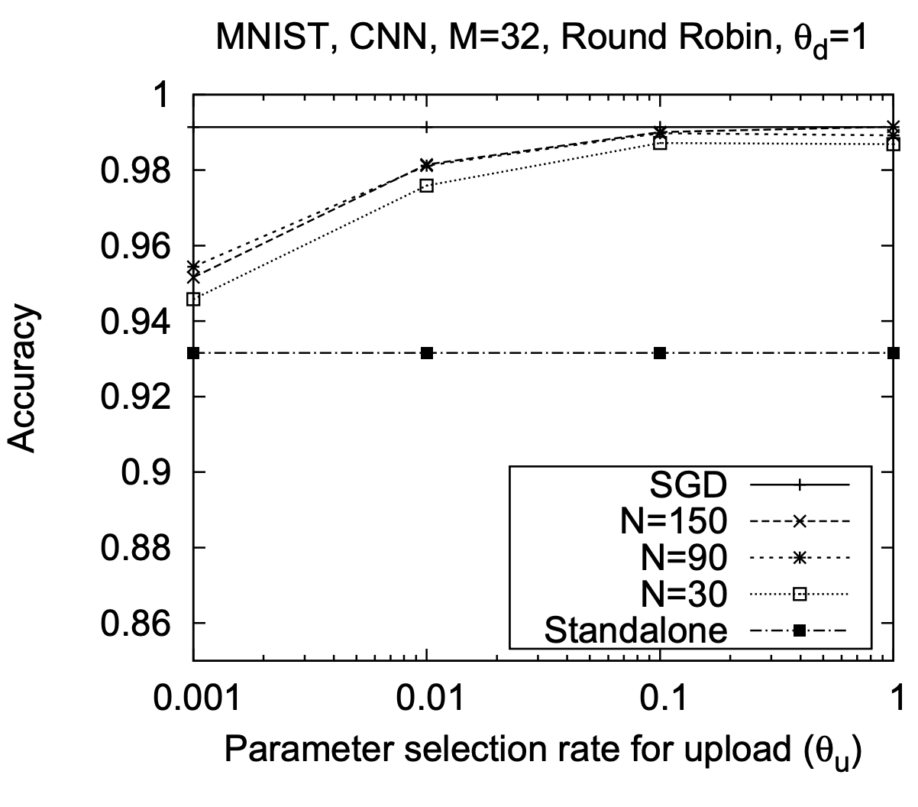
Results
Fully centralized training
Improvement
Fully local training
600 training samples
Per user

Slide 37
Privacy Properties
Participants’ datasets remain private
Full control over parameter selection
Known learning objective
Resulting model available to all parties

Slide 38


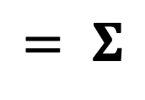
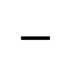

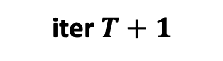
Threat Model
Malicious participant or server has WHITE-BOX access to model updates!
What information do updates leak?
Server
Detect weights that are given higher important
Infer feature that is more important
$$−$$
$$= Σ$$
iter $T+1$
iter $T$
Gradients based on a batch of data

Slide 39




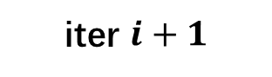

Property Inference Attacks
Inferring properties from observation = learning problem
Labeled with property
Server
…
$$−$$
iter $i+1$
iter $i$
iter $1$
iter $2$
iter $T$
Infer
…
Train
Labeled
updates
Labeled
updates
Labeled
updates
Property Classifier
Detect weights that are given higher important
Infer feature that is more important

Slide 40
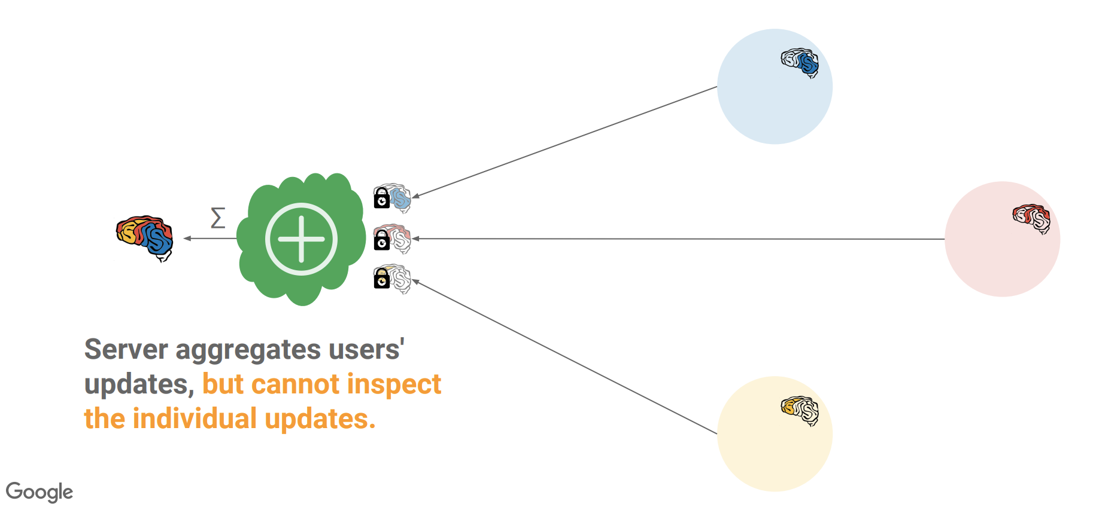
Secure aggregation

Slide 41
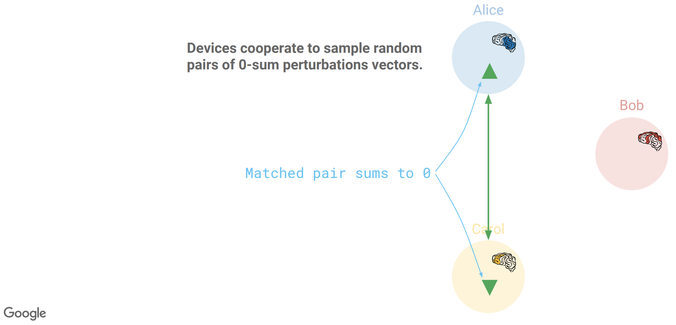
Random positive/negative pairs, aka antiparticles

Slide 42
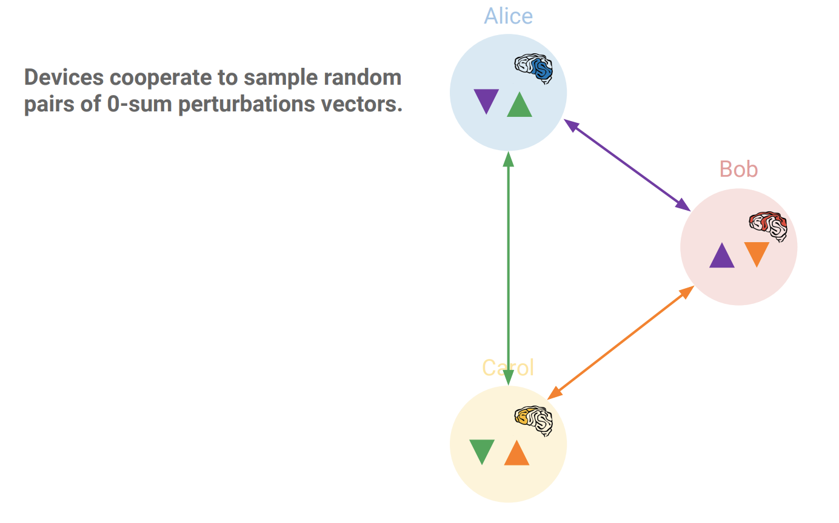
Random positive/negative pairs, aka antiparticles …

Slide 43
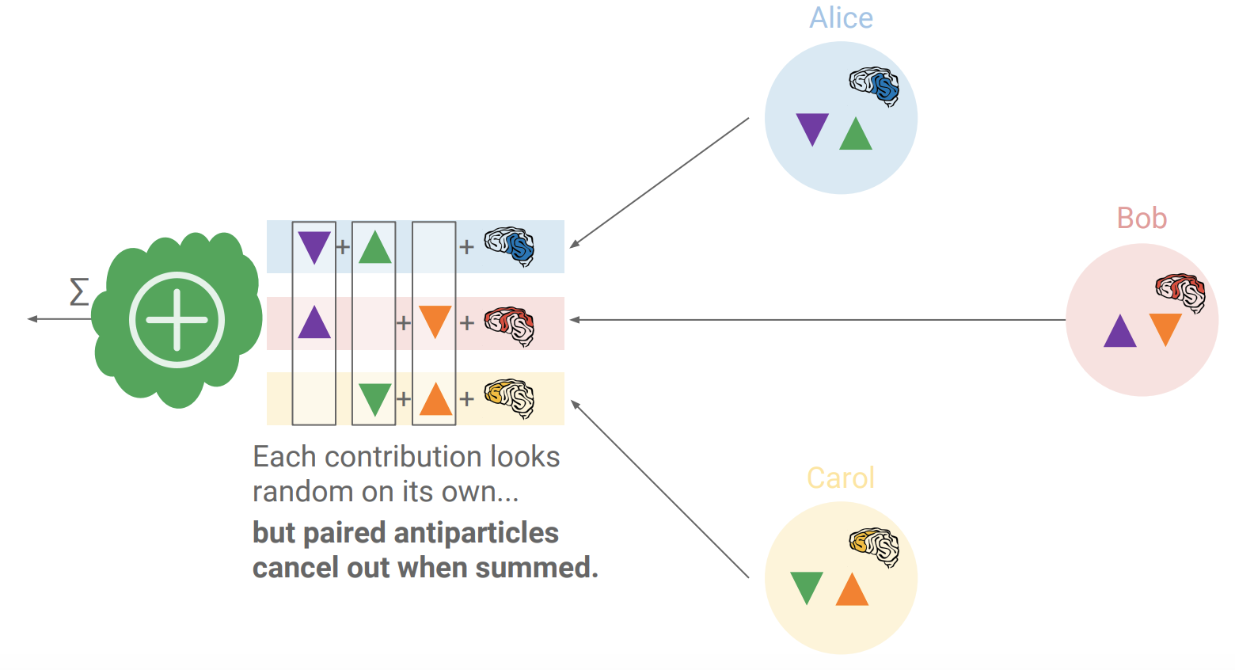
The antiparticles cancel when summing contributions
Can use secret sharing techniques to count for faulty nodes
See: http://jakubkonecny.com/files/2018-01_UW_Federated_Learning.pdf

Slide 44
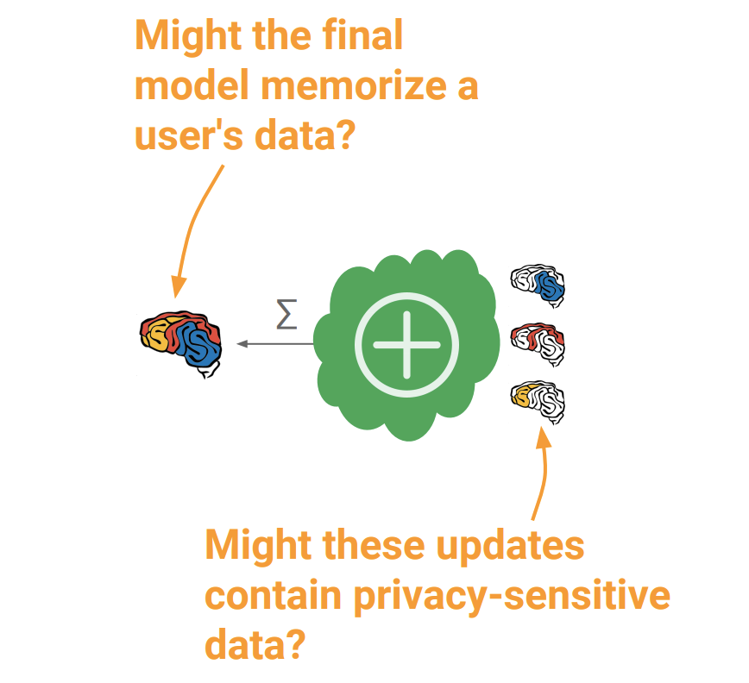
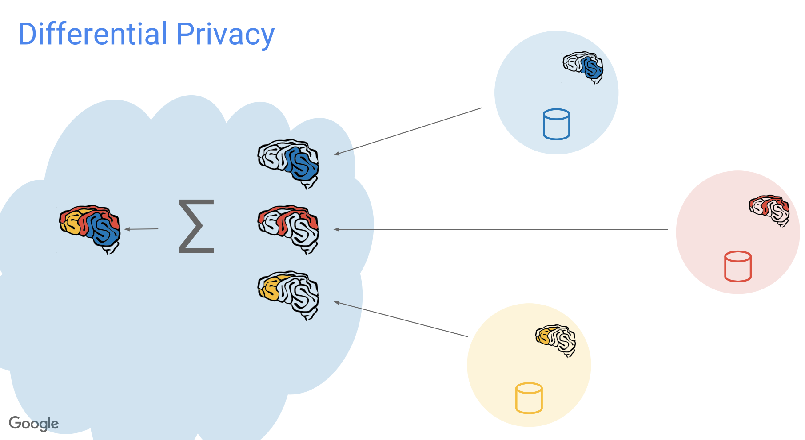
Could the final model leak information
What could we do?

Slide 45
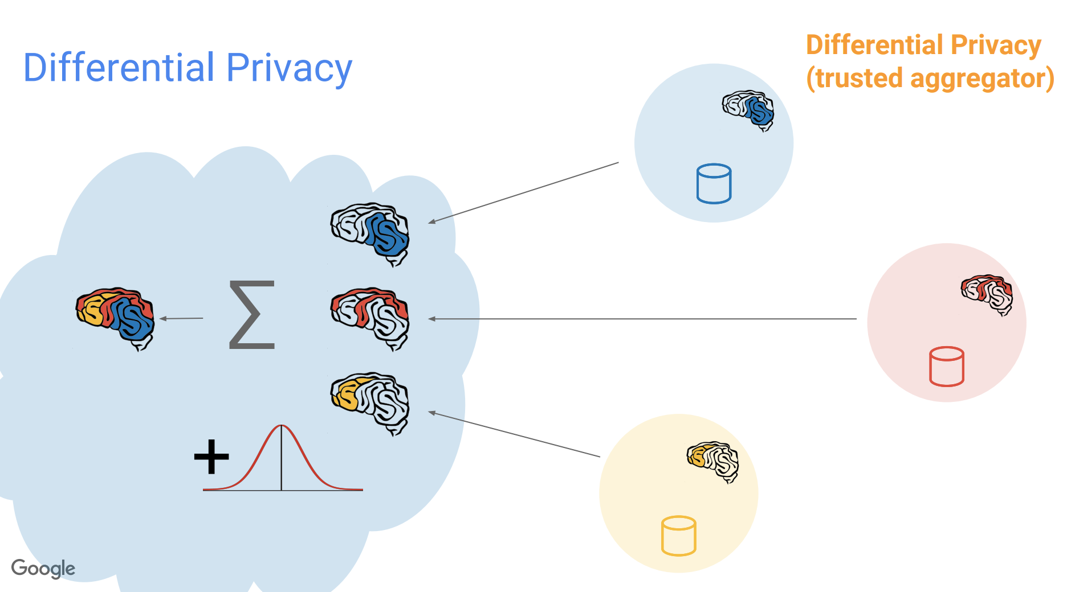
Differentially Private aggregation
At the server side
Assuming server is semi-honest

Slide 46
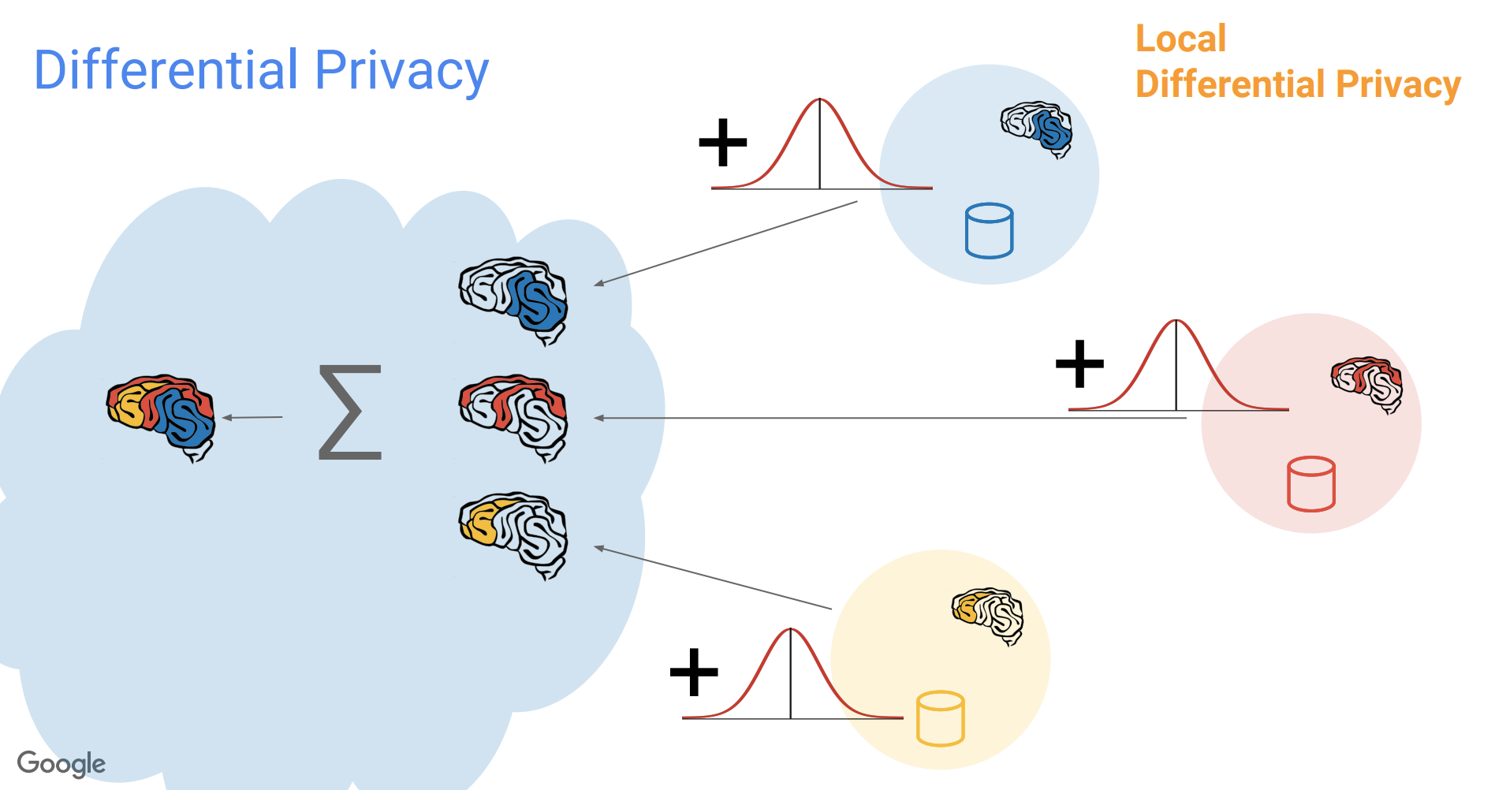
Differentially Private aggregation
At the client side
Assuming server is not honest

Slide 47
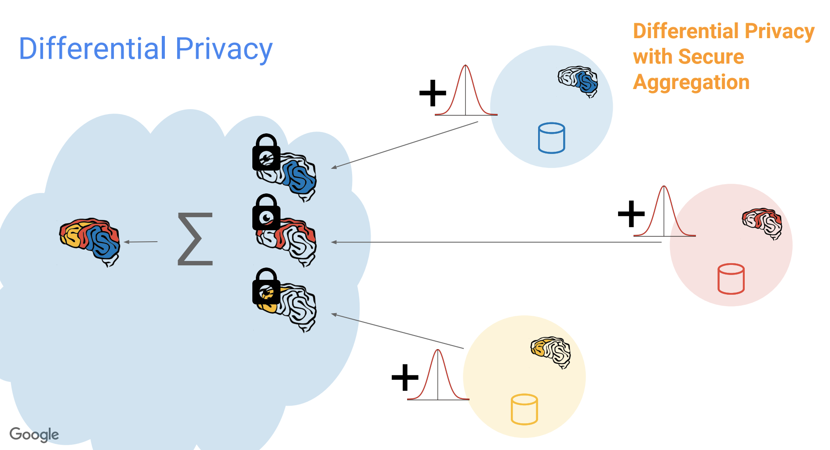
DP + secure aggregation

Slide 48
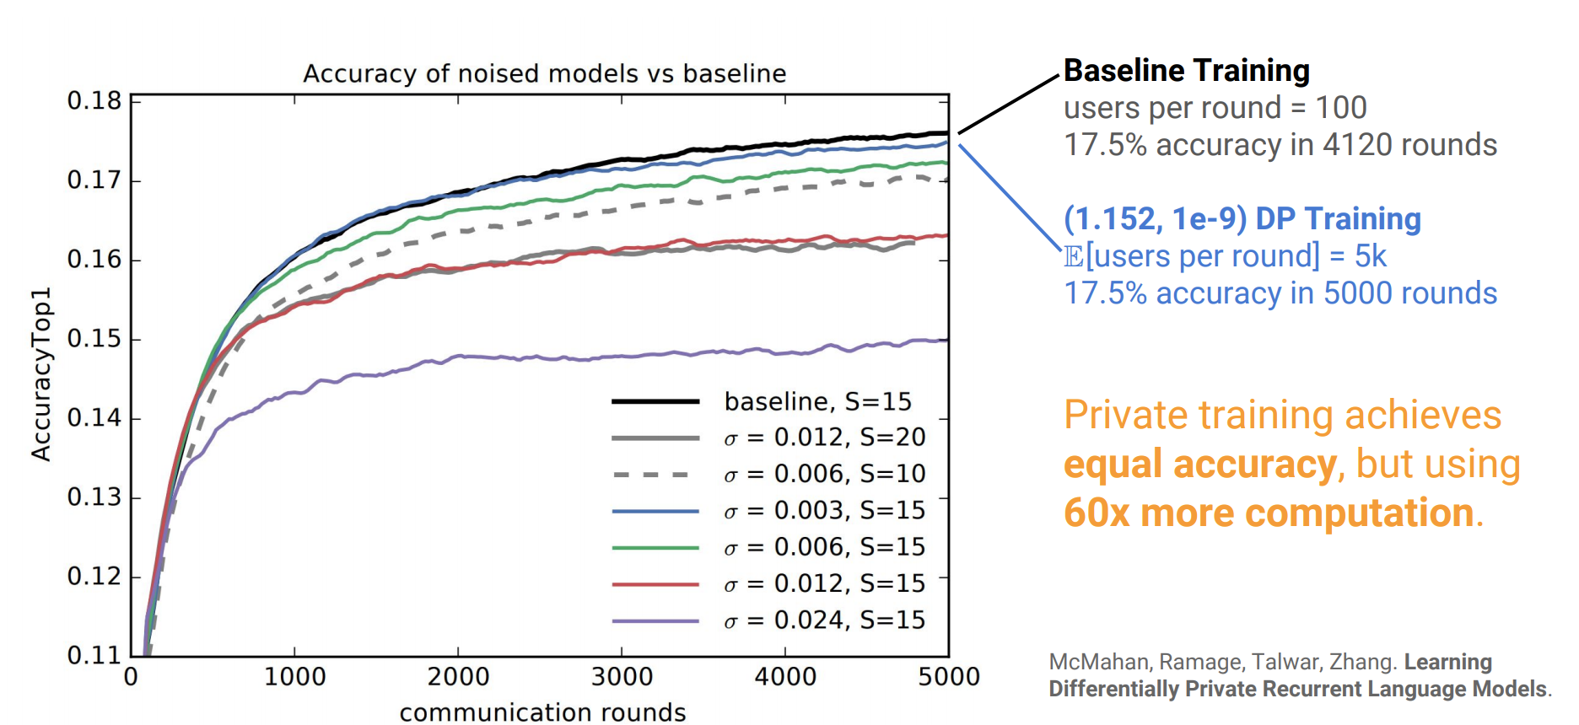
Using Differential Privacy for Federated Language Models

Slide 49
What did we learn
Massive data collection required for deep learning presents substantial privacy risks
Privacy-preserving deep learning system (federated learning)
Holders of sensitive data collaborate to build powerful models without sharing their data
Differentially-private information exchange protocol
Prevents indirect leakage about participants’ private datasets
Accuracy of system
is substantially better than that of standalone learning
is very close to accuracy of centralized SGD

Slide 50
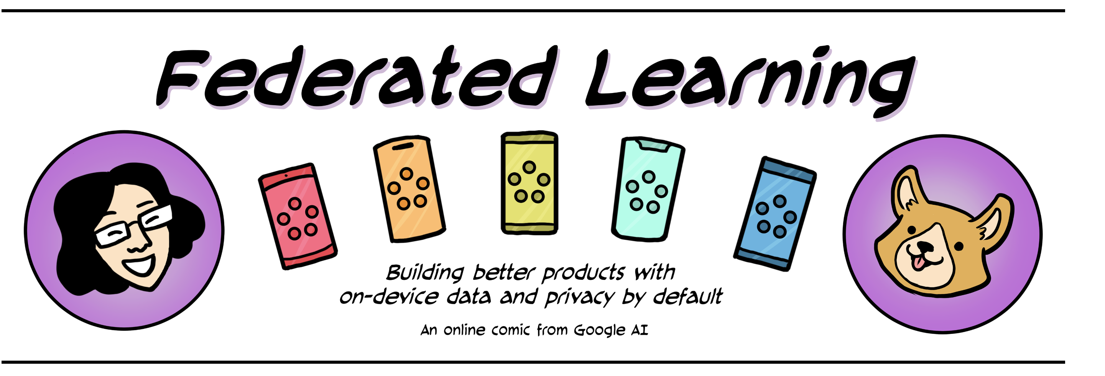
Useful links
Useful resources:
https://federated.withgoogle.com/
http://jakubkonecny.com/files/2018-01_UW_Federated_Learning.pdf
https://www.tensorflow.org/federated

Slide 51
Logistics
Home work 3 due today @11:59pm
Home work 4 will be released tomorrow

